Slide 1
Park Pay Wireless
The future of parking

Slide 2
Executive summary
We are building a simple, fair automated parking payment system for on street parking.
This will maximise revenue for councils and significantly improve customer experience while also reducing costs.
We have spoken to both councils and consumers – who love the idea.

Slide 3
Market need
Almost 50% of all drivers use street parking on a regular basis.
Motorists are expected to know for how long the vehicle will be parked.
Significant inconvenience if the need arises to extend parking.
The entire parking process takes a long time.
Notes:
What is the market?
What problem are you solving and for whom?
Who are the key players?

Slide 4
Market Size
Total Available Market (TAM) = 30 million people
Serviceable Available Market (SAM):
Phase 1 = 70,000 people (7000 small businesses)
Phase 2 = 500,000 people
Phase 3 = 15 million people
Serviceable Obtainable Market (SOM):
Phase 1 = 20,000 people
Phase 2 = 170,000 people
Phase 3 = 1 million people
Notes:
TAM/SAM/SOM

Slide 5
Customer Feedback
We have spoken to multiple people who have liked the idea.
We have also refined and revised our idea based on feedback we received through market research.
Notes:
Any interactions to date?

Slide 6


Value proposition
“Cars should manage their own parking payments”
Notes:
What is the technology offer?

Slide 7
Key benefits to customers
Customers only pay for the duration that the vehicle is parked.
A customer avoids getting issued parking tickets.
A customer avoids additional convenience charges for extending the parking.
A customer has peace of mind.
The inconvenience of paying for parking is eliminated.
Notes:
Is there any cost analysis?
What are the advantages over the competition?
Why is it unique and for whom?

Slide 8
Strategy
Phase 1: Sell to small business that have workers that travel around and park often
Phase 2: Sell to consumers using the traction generated from Phase 1
Phase 3: Sell to more consumers in a wider geographical area using traction generated in Phase 2
Notes:
Summary of the value chain and position of newco

Slide 9
Business Model
We plan to charge customers for the device and a small convenience fee for each parking transaction.
The target customers are:
Phase 1: Small businesses/professionals in Cambridgeshire.
Phase 2: Motorists in Cambridgeshire
Phase 3: Expand to other areas of the United Kingdom
Notes:
Licence? Outsource? Manufacturing?
When will you have a product ready to sell?

Slide 10
Barriers to adoption
The main barrier to adoption will be the initial cost of the device.
This can be overcome with
the active support of town councils (who are on board with our idea)
effective marketing
using the traction gained in the market earlier to expand
Notes:
How will these be overcome?

Slide 11
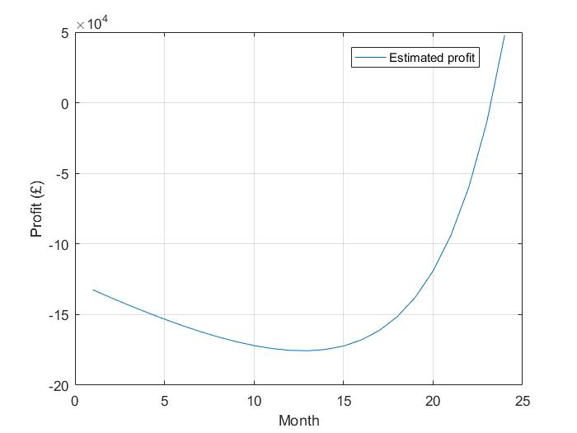
Financial Model
Notes:
Simple profit and loss, and cash flow

Slide 12
Team
Harish Shivaraj
CEO
Student at University of Oxford in Software Engineering
Miquel Izquierdo
CTO
Several years of hardware, firmware development experience
Nisarg Mehta
COO
Student at University of Cambridge in Information Engineering
Notes:
Current members
CVs
Skills still needed
Recruitment plans?

